Slide 1
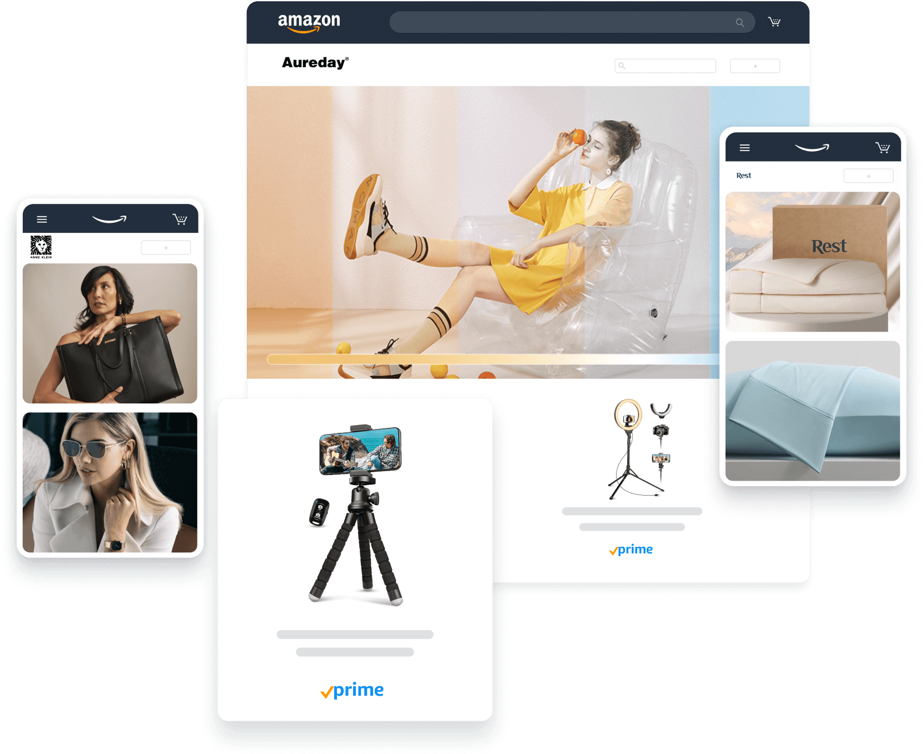
What is ecommerce?
sumber: https://sell.amazon.com/

Slide 2
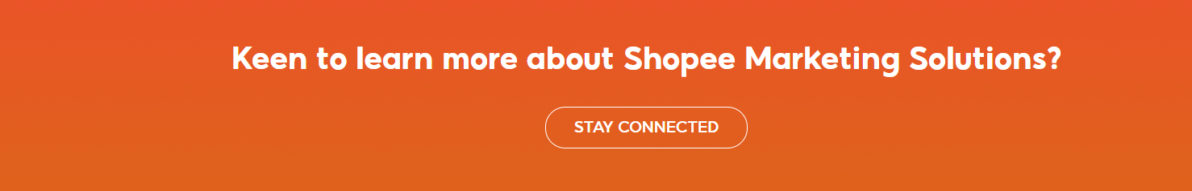

Slide 3
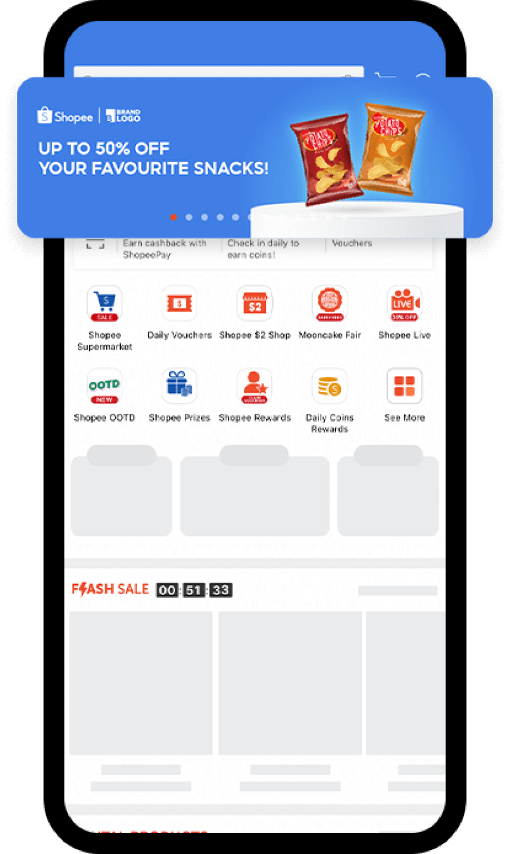
Branding Solutions
Performance Solutions
Content Solutions
Engagement Solutions

Slide 4
